Slide 1
Cornerstone City Church Peninsula Plus Community Hoo Are Ya 08-07-2022

Slide 2
Hosanna (Praise Is Rising)
CCLI Song # 4662491
Brenton Brown | Paul Baloche
© 2005, 2006 Integrity's Hosanna! Music (Admin. by Integrity Music Ltd)
Thankyou Music (Admin. by Integrity Music Ltd)
For use solely with the SongSelect® Terms of Use. All rights reserved. www.ccli.com
CCLI Licence No. 33265

Slide 3
1/6
Praise is rising
Eyes are turning to You
We turn to You
Hope is stirring
Hearts are yearning for You
We long for You

Slide 4
2/6
‘Cause when we see You
We find strength to face the day
In Your presence
All our fears are washed away
(Washed away)

Slide 5
3/6
Hosanna Hosanna
You are the God who saves us
Worthy of all our praises
Hosanna Hosanna
Come have Your way among us
We welcome You here Lord Jesus

Slide 6
4/6
Hear the sound of
Hearts returning to You
We turn to You
In Your Kingdom
Broken lives are made new
You make us new

Slide 7
5/6
‘Cause when we see You
We find strength to face the day
In Your presence
All our fears are washed away
(Washed away)

Slide 8
6/6
Hosanna, Hosanna
You are the God who saves us
Worthy of all our praises
Hosanna Hosanna
Come have Your way among us
We welcome You here Lord Jesus

Slide 9
Our God
CCLI Song # 5677416
Chris Tomlin | Jesse Reeves | Jonas Myrin | Matt Redman
© 2010 sixsteps Music (Admin. by Integrity Music)
Thankyou Music (Admin. by Integrity Music)
Vamos Publishing (Admin. by Integrity Music)
worshiptogether.com songs (Admin. by Integrity Music)
Atlas Mountain Songs (Admin. by SHOUT! Music Publishing UK)
For use solely with the SongSelect® Terms of Use. All rights reserved. www.ccli.com
CCLI Licence No. 33265

Slide 10
1/3
Water You turned into wine Opened the eyes of the blind There's no one like you None like you Into the darkness You shine Out of the ashes we rise There's No one like you None like you

Slide 11
2/3
Our God is greater,
Our God is stronger God You are higher than any other Our God is Healer,
Awesome in power Our God, Our God

Slide 12
3/3
And if Our God is for us,
Then who could ever stop us? And if our God is with us,
Then what can stand against?

Slide 13
Goodness Of God
CCLI Song # 7117726
Ben Fielding | Brian Johnson | Ed Cash | Jason Ingram | Jenn Johnson
© 2018 Capitol CMG Paragon (Admin. by Capitol CMG Publishing)
Fellow Ships Music (Admin. by Essential Music Publishing LLC)
So Essential Tunes (Admin. by Essential Music Publishing LLC)
SHOUT! Music Publishing Australia (Admin. by SHOUT! Music Publishing UK)
Bethel Music Publishing (Admin. by Song Solutions)
For use solely with the SongSelect® Terms of Use. All rights reserved. www.ccli.com
CCLI Licence No. 33265

Slide 14
1/4
I love You Lord
Oh Your mercy never fails me
All my days
I've been held in Your hands
From the moment that I wake up
Until I lay my head
I will sing of the goodness of God

Slide 15
2/4
All my life You have been faithful
All my life You have been so so good
With every breath that I am able
I will sing of the goodness of God

Slide 16
3/4
I love Your voice
You have led me through the fire
In darkest night
You are close like no other
I've known You as a father
I've known You as a friend
I have lived in the goodness of God

Slide 17
4/4
Your goodness is running after
It’s running after me
Your goodness is running after
It’s running after me
With my life laid down
I’m surrendered now
I give You everything
Your goodness is running after
It's running after me

Slide 18
What a Beautiful Name
CCLI Song # 7068424
Ben Fielding | Brooke Ligertwood
© 2016 Hillsong Music Publishing Australia (Admin. by Hillsong Music Publishing UK)
For use solely with the SongSelect® Terms of Use. All rights reserved. www.ccli.com
CCLI Licence No. 33265

Slide 19
1/7
You were the Word at the beginning
One with God the Lord Most High
Your hidden glory in creation
Now revealed in You our Christ

Slide 20
2/7
What a beautiful Name it is
What a beautiful Name it is
The Name of Jesus Christ my King
What a beautiful Name it is
Nothing compares to this
What a beautiful Name it is
The Name of Jesus

Slide 21
3/7
You didn't want heaven without us
So Jesus You brought heaven down
My sin was great Your love was greater
What could separate us now

Slide 22
4/7
What a wonderful Name it is
What a wonderful Name it is
The Name of Jesus Christ my King
What a wonderful Name it is
Nothing compares to this
What a wonderful Name it is
The Name of Jesus

Slide 23
5/7
Death could not hold You
The veil tore before You
You silence the boast of sin and grave
The heavens are roaring
The praise of Your glory
For You are raised to life again

Slide 24
6/7
You have no rival
You have no equal
Now and forever God You reign
Yours is the kingdom
Yours is the glory
Yours is the Name above all names

Slide 25
7/7
What a powerful Name it is
What a powerful Name it is
The Name of Jesus Christ my King
What a powerful Name it is
Nothing can stand against
What a powerful Name it is
The Name of Jesus

Slide 27


Slide 28


Slide 29
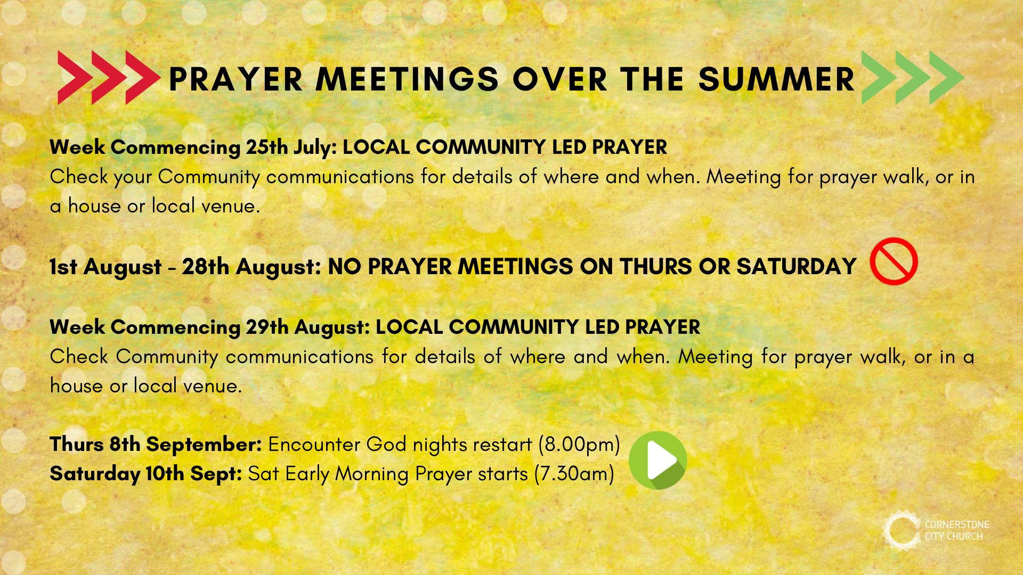

Slide 30


Slide 31


Slide 32
Majesty
CCLI Song # 4219071
Martin Smith | Stuart Garrard
© 2003, 2004 Curious? Music UK (Admin. by Integrity Music Ltd)
For use solely with the SongSelect® Terms of Use. All rights reserved. www.ccli.com
CCLI Licence No. 33265

Slide 33
1/4
Here I am
Humbled by Your majesty
Covered by Your grace so free
Here I am
Knowing I'm a sinful man
Covered by the blood of the Lamb

Slide 34
2/4
Now, I've found
The greatest love of all, is mine
Since You laid down Your life
The greatest sacrifice

Slide 35
Majesty majesty
Your grace has found me just as I am
Empty handed but alive in Your hands
Majesty majesty
Forever I am changed by Your love
In the presence of Your majesty
3/4

Slide 36
4/4
Here I am
Humbled by the love that You give
Forgiven so that I can forgive
Here I stand
Knowing that I'm Your desire
Sanctified, by glory and fire

